Slide 1
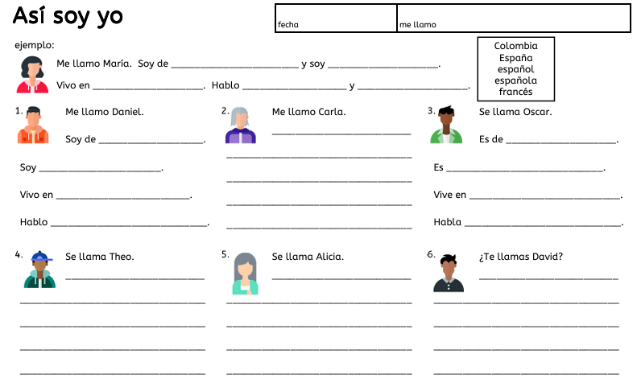
España
española
Colombia
español
francés

Slide 2
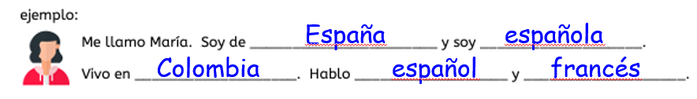
Where are they from?
Their nationality?
Where do they live?
What language(s) do they speak?

